Slide 1



ProjectPRISM
PROJECT
PRISM
A Project Management Tool for Engineers

Slide 2

OVERVIEW
01
02
03
Our Team
About Us
Technology Used
04
05
06
Features
Project
Summary

Slide 3







OUR TEAM
Vipul Shridhar Rajderkar
Sneha Yenduri
Pranay Prasad Pindi
Joseph Joshi Aerrolla

Slide 4


ABOUT US
Project Prism stands as an advanced project management tool crafted to elevate the capabilities of engineering teams. Utilizing React and Node, this holistic platform delivers a seamless, productive, and adaptable space for teams to strategize, monitor, and oversee their projects with precision.

Slide 5

TECHNOLOGY USED
❑ MongoDB – For Database
❑ Backend –
NodeJS
Express
ReactJS
HTML
JavaScript
TypeScript
❑ Frontend –

Slide 6


FEATURES
PROJECT DASHBOARD
Access a comprehensive overview of all your projects through a centralized dashboard. Monitor project progress instantly with a quick glance.

Slide 7

TASK MANAGEMENT
Divide projects into individual Work items. Allocate these items to team members, establish priorities, and monitor real-time status updates.

Slide 8
IMPLEMENTATION

Slide 9
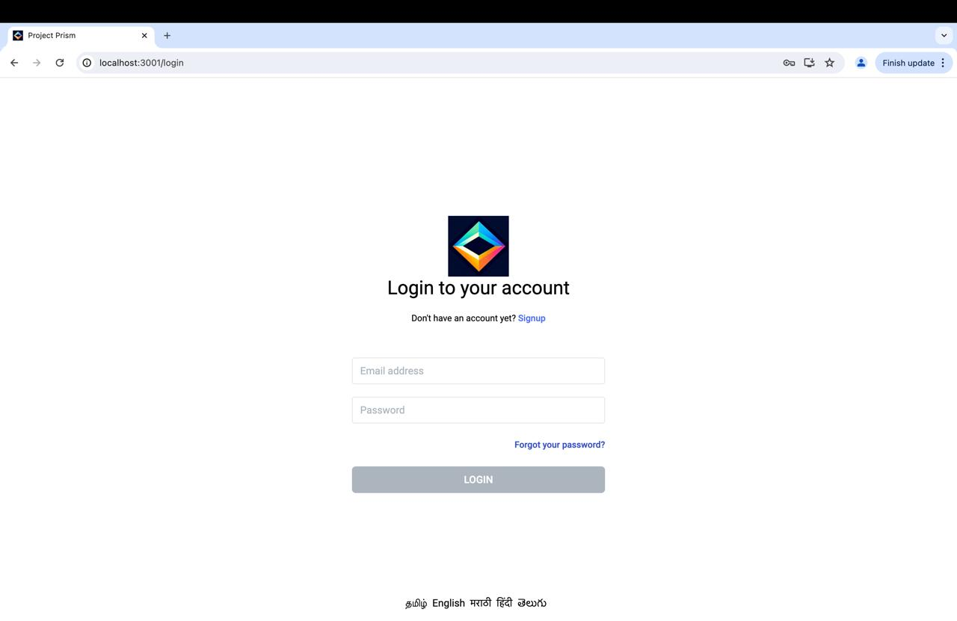
Login
With a simple and secure login interface, Project Prism’s entry point keeps user experience at the forefront, offering quick links to signup for new users and password retrieval.

Slide 10
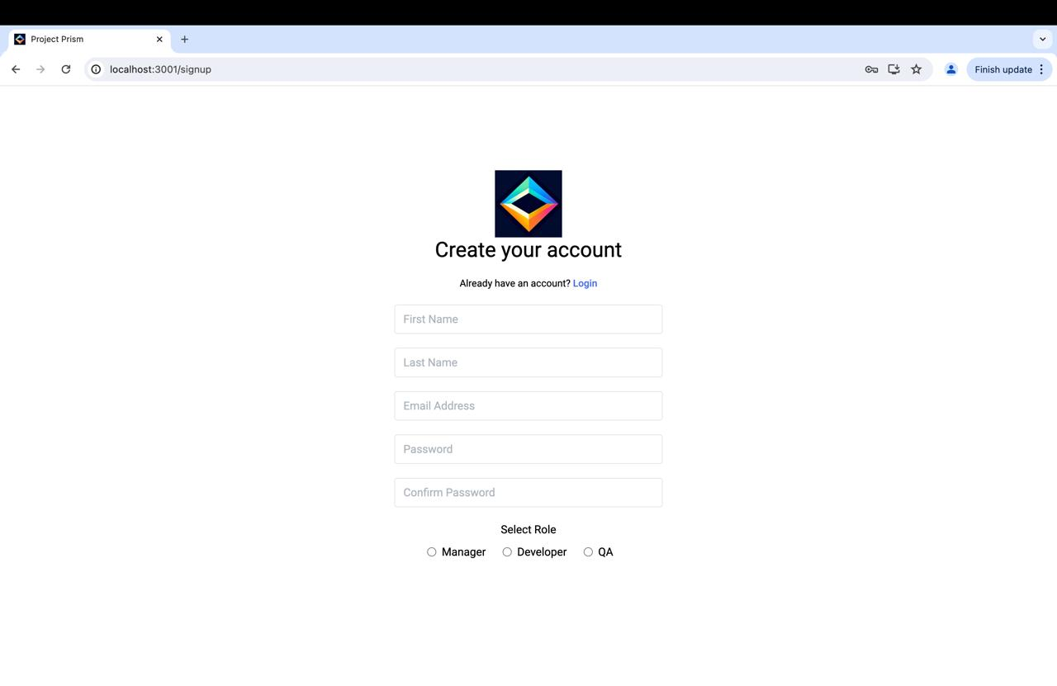
Sign Up
Project Prism invites new users to create their account effortlessly, with fields for personal details and role selection for tailored access.

Slide 11
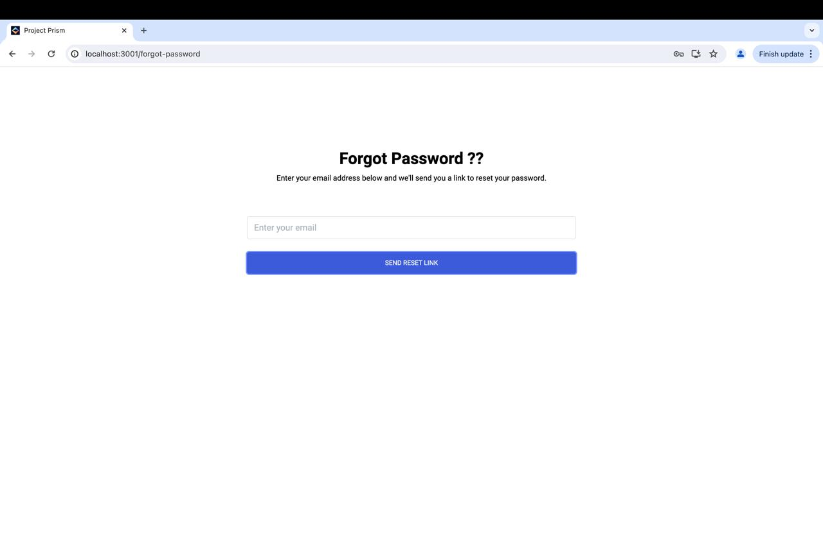
Forgot Password
Project Prism provides a secure method for users to reset their passwords, ensuring account recovery is both simple and safe.

Slide 12
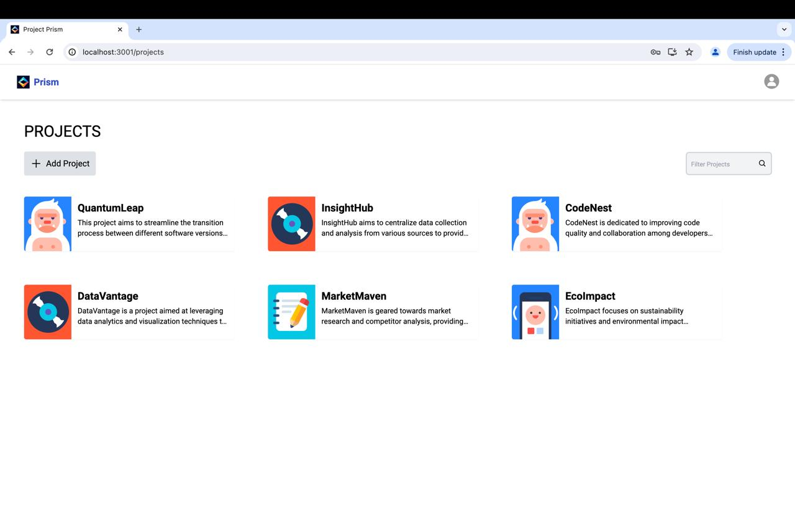
Dashboard
Prism presents a vibrant dashboard showcasing various projects, each with unique goals and summaries.

Slide 13
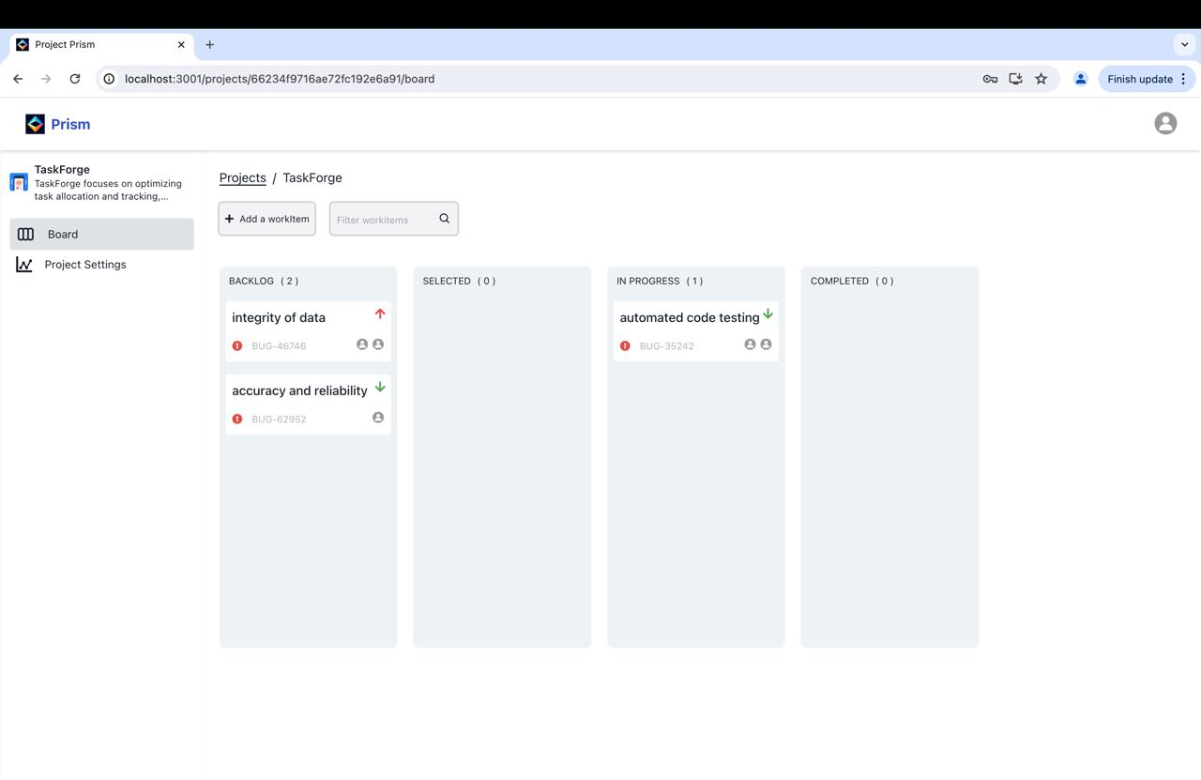
Kanban Board
Project Prism offers an organized Kanban board, streamlining project tracking from backlog to completion.

Slide 14
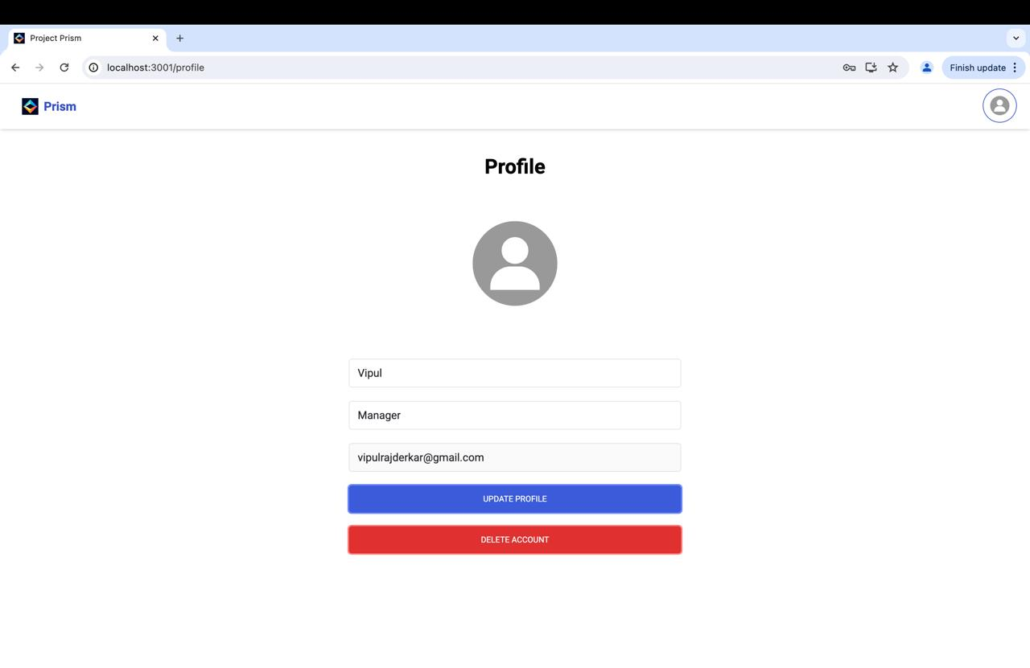
Profile
The profile page in Project Prism is a personal space for users to update their details, with clear options to modify information or securely delete the account.

Slide 15
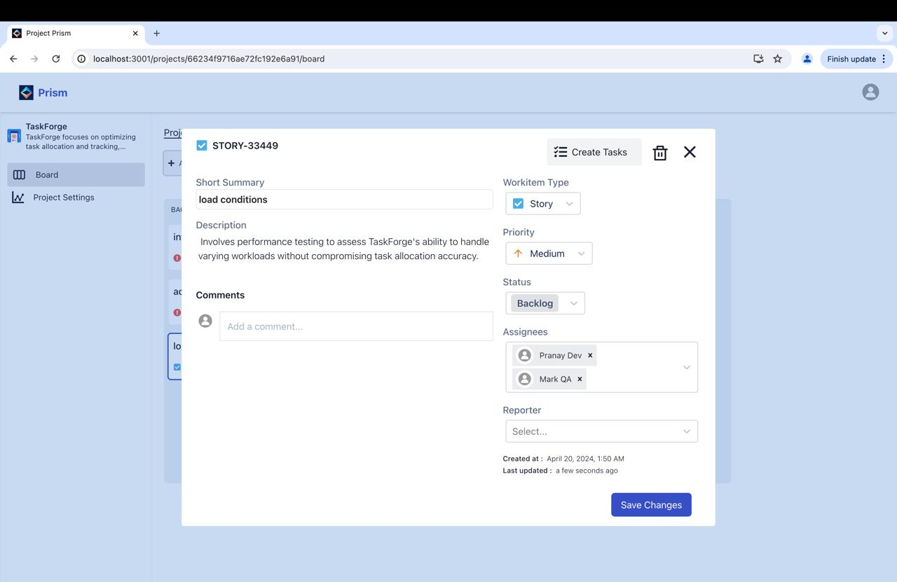
Create Work Item
Project Prism enables team collaboration by assigning tasks to developers and QA, ensuring clear communication and tracking of progress right from the creation of a work item.

Slide 16
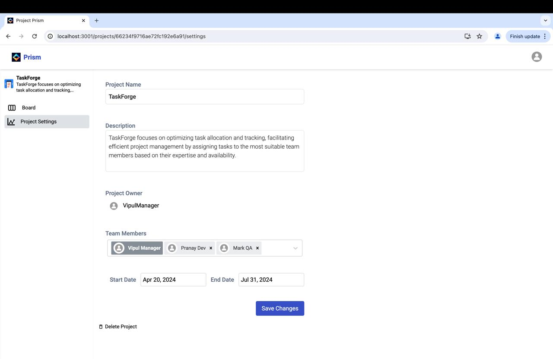
Project settings
In the settings, you can customize your project setup by naming your project, outlining its description, and adding team members with their respective roles.

Slide 17

SUMMARY
In conclusion, Project Prism is more than just a project management tool; it's a dynamic solution that enables engineering teams to collaborate seamlessly, visualize workflows effectively, and ultimately achieve project success.

Slide 18

ProjectPRISM
Thank You

